Slide 1



BDA
GROUP PROJECT
BY QUANTUM QUADS

Slide 2


Meet Our TEAM MEMBERS
ROLL NUMBERS: -
B24BS2312
B24BS2371
B24BS2167
B24BS2137
MEMBERS:-
SAMIKSHA KAUSHIK
SURESH JANGID
KRISHNA PRATAP SINGH
ISHITA

Slide 3
Background
The project's goal is to determine if a social media campaign's viral buzz translated into valuable students who actually finish their courses. As a Data Analyst at VidyaVerse, our mission is to lead a data-driven investigation using a full data analytics workflow.

Slide 4
Project Goals
As a Data Analyst, your mission is to lead this investigation from raw datasets to a final analysis.The key objectives are to:
Apply a complete data analytics workflow including data cleaning, integration, and final analysis.
Leverage a modern toolset such as SQL, Python, Notion AI, and MindMup.
Craft a compelling data story and present a clear recommendation to the Head of Growth
The project also aims to answer specific business questions, such as which platform attracted students with the highest course completion rates, whether ad spend on a particular platform was justified, and if a "Success Profile" of a student can be created. The end goal is to deliver a "Single Source of Truth" master dataset, an "Insight Dashboard" summarizing ROI, and a "Strategic Playbook" for future marketing investments

Slide 5
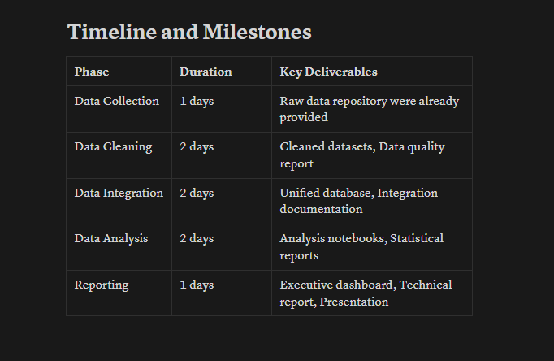
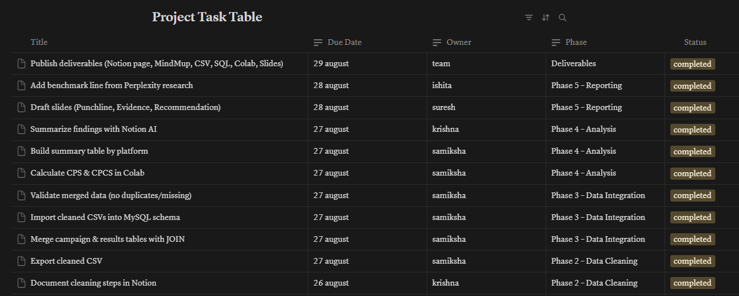
Phase 1: Mission Scoping & Hypothesis Mapping
Using the Notion AI tool, We first of all found out what are the tasks, heir completions deadlines and assigned the tasks to each other. When the task were completed, we converted the To Do List from ‘to be done’ to ‘completed’.

Slide 6
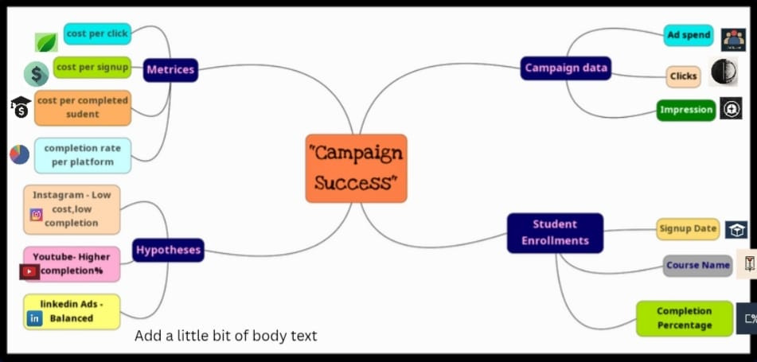
Phase 1: Mission Scoping & Hypothesis Mapping
The image is a MindMup diagram for a project on "Campaign Success." It maps out key components like campaign data (ad spend, clicks), student enrollments (completion percentage), and metrics to be calculated (cost per completed student). The diagram also includes initial hypotheses for different social media platforms.

Slide 7
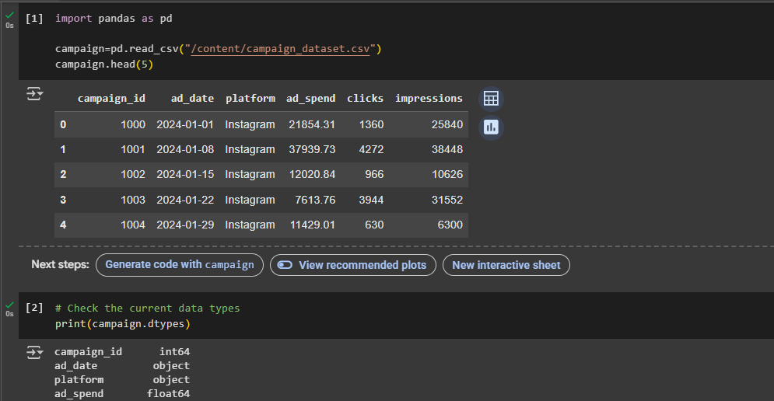
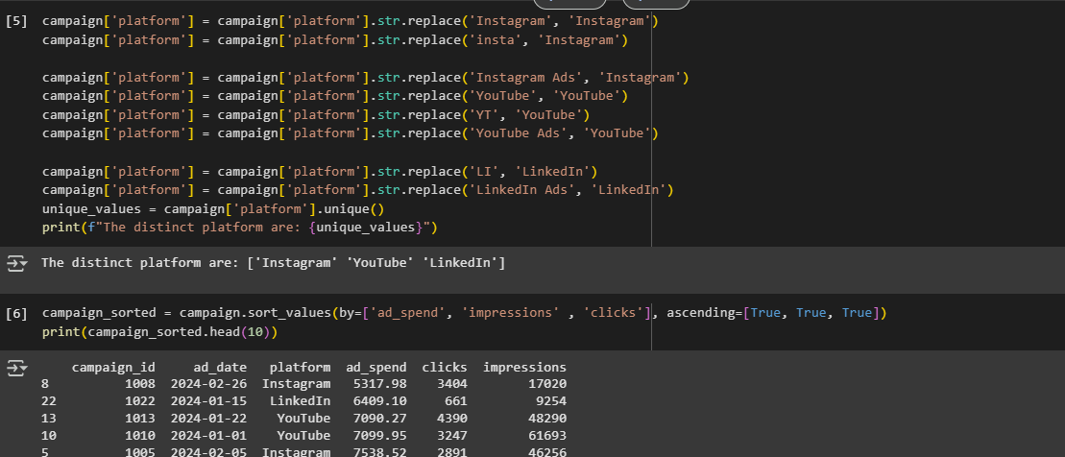
Phase 2: The Data Laundromat
Goole Colab and Python
Loaded campaign_performance.csv into a Pandas DataFrame in Google Colab.
Cleaned the data by standardizing the platform column and removing duplicates.
Documented the cleaning decisions and export the cleaned data to campaigns_cleaned.csv

Slide 8
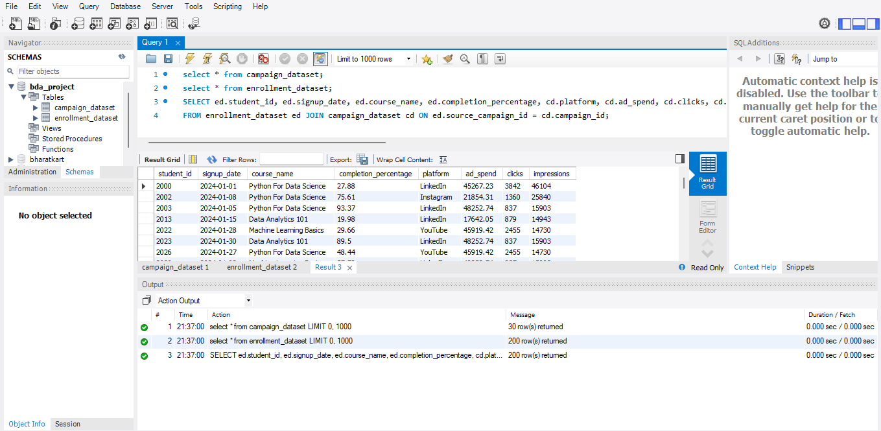
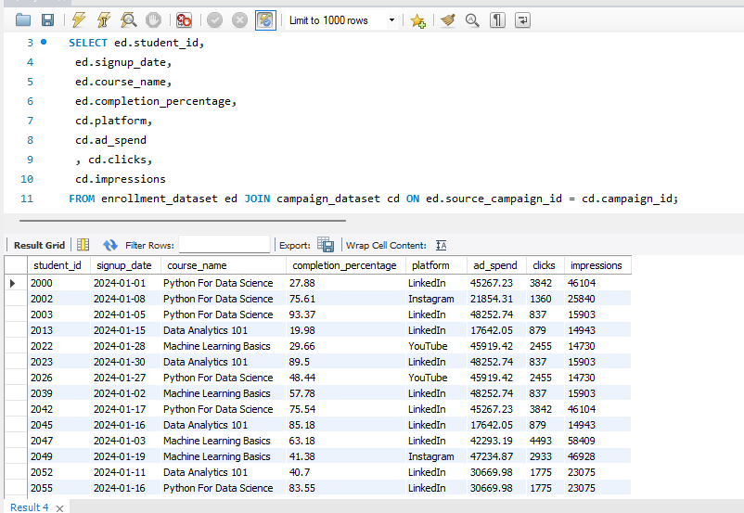
Phase 3: The Great Merge
We had set up a vidyaverse_analytics schema in MySQL Workbench and import student_enrollments.csv and campaigns_cleaned.csv.
Crafted a SQL query using a JOIN to link the two tables.
Validated the merged data to ensure accuracy and export the final result to master_analytics_data.csv

Slide 9
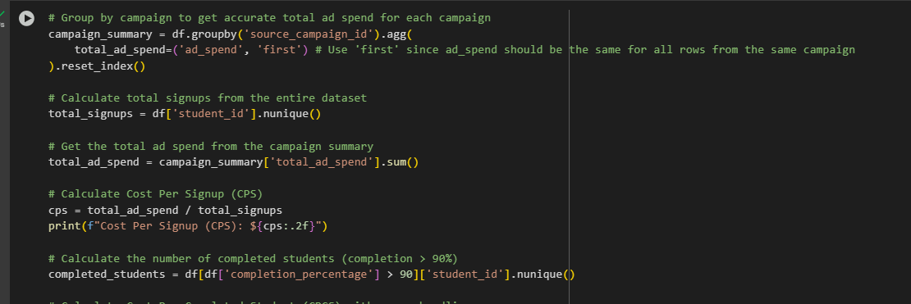
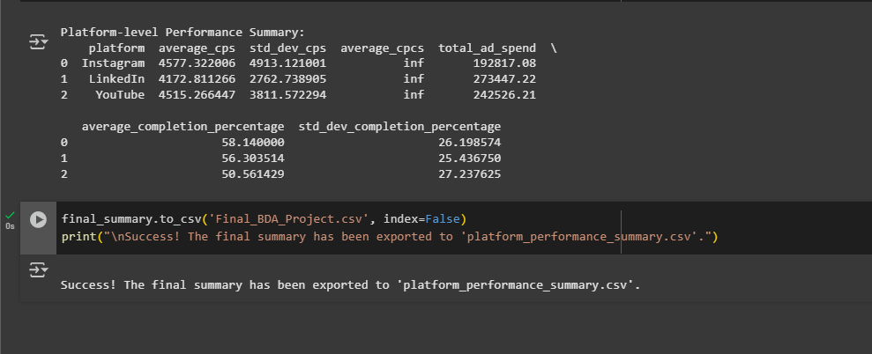
Phase 4: The Eureka Moment - Analysis
Loaded master_analytics_data.csv into a new Pandas DataFrame.
Did the key metrics such as Cost Per Signup (CPS) and Cost Per Completed Student (CPCS).
Grouped the data by platform to calculate average completion percentage, CPS, and CPCS.

Slide 10
Phase 5: Crafting the Data Story
Priya Sharma, Head of Growth at VidyaVerse, needs to know if the recent viral social media campaign, "#DataDreamer," was a success or merely a source of "vanity metrics". You, a new Data Analyst, must investigate whether the campaign's buzz translated into valuable students who actually finish their courses. Your mission is to lead a data-driven investigation, applying a full analytics workflow from data cleaning to final analysis.
Our journey begins with data cleaning using Python, where you'll standardize platform names like 'insta' and 'Instagram Ads' to 'Instagram'. Next, we’ve performed a great merge in MySQL, crafting a SQL JOIN query to connect raw ad performance data with student enrollment details, creating a master dataset. The core of your project is the analysis, where you'll engineer a "killer metric"—the Cost Per Completed Student (CPCS)—to determine which platform delivered the highest ROI.
Finally, we’ve craft a data story and present a clear recommendation to Priya Sharma. Your presentation will start with a punchline, like "YouTube Delivers 2x Higher ROI Despite Higher Costs," supported by your analysis. This will lead to a strategic playbook for future marketing investments, solidifying your role as a key contributor to the company's growth

Slide 11
Thank You
FINAL DRIVE LINK

